Slide 1
Physics 2 – Feb 4, 2020
Today’s Objective:
3.2 Thermal Physics; Gases
Assignment:
Ch 3.2, p140, #13-21
Agenda
The mole and ideal gases
Simple gas Laws
Ideal gas law

Slide 2
The mole and N_{A}
Because atoms are so small, we need a way to count them.
The mole is a unit that functions like a dozen. It’s just a collection of some number of items.
You can have a mole of anything. Just like you can have a dozen of anything.
While a dozen is 12. A mole is 6.022 x 10²³ items.
6.022 x 10²³ is Avogadro’s number and symbolized N_{A}.

Slide 3
Atomic mass and Molar mass
On the periodic table, the number under each element symbol provides the atomic mass of one atom of the element in u, atomic mass units.
N_{A} was chosen such that this number ALSO tells the mass of one mole of atoms in grams, which is called the molar mass, μ.
The number of moles of a substance is indicated by n.
Be able to convert mass to moles for any substance using its molar mass. (from chemistry class- use factor label methods)
$$a.m.u=u=\frac{1 g}{N_{A}}$$
n$=\frac{m}{μ}$

Slide 4
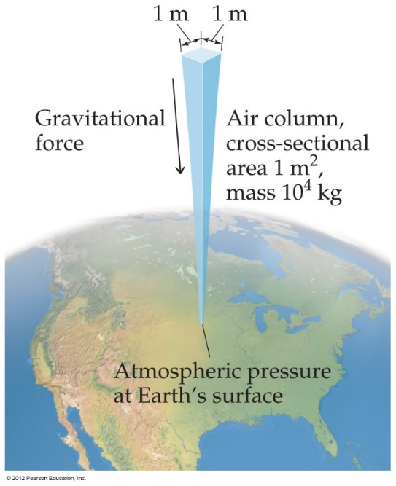
Pressure
Pressure is the amount of perpendicular force applied to an area
Atmospheric pressure is the weight of air per unit of area.
Pascals (SI Unit)
1 Pa = 1 N/m² IB exclusively uses Pa and atm
Atmosphere
1.00 atm = 760 torr = 101,325 Pa = 1.01325 Bar = 1013.25 mbar

Slide 5
Standard Pressure and Temperature (STP)
Normal atmospheric pressure at sea level is referred to as standard pressure.
It is equal to
1.00 atm
Standard temperature is 0◦C = 273 K
Together they are STP and are very common condition for measuring physical constants.

Slide 6
Ideal gases (assumptions)
An ideal gas follows all of the assumptions of the kinetic theory of matter:
Molecules are point particles with negligible volume.
The particles obey mechanics and move with constant velocity.
Molecules have a range of speeds and move randomly.
There are no forces between molecules unless they collide.
The time for collisions is relatively negligible.
Collisions of molecules and with the walls are elastic.

Slide 7
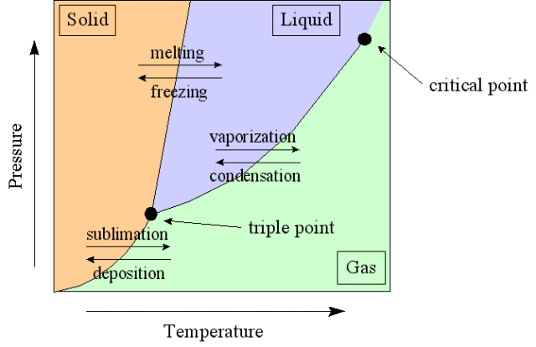
Ideal and Real gases
A real gas can be converted into liquids and solids and exists on a Pressure Temperature diagram called a phase diagram.
Ideal gases stay gases at all temperatures and pressures.
Real gases approximate ideal gases at low pressures and high temperatures, when the density is low.
At high pressures, the molecules interact.
At low temperatures, they may condense or solidify.

Slide 8
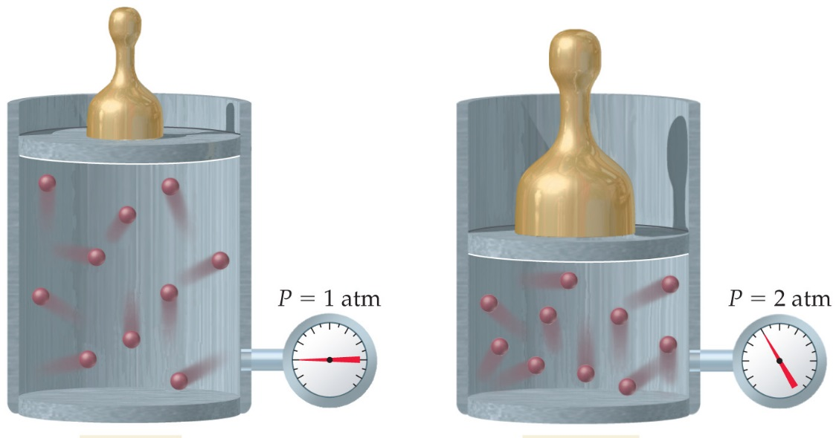
Boyle’s PV Law
Consider any given sample of gas in a compressible container with a piston attached
As you compress the gas, what happens to the pressure of the gas?
Pressure proportional to mass
Volume proportional to height
Measure height of piston for various masses.
As mass increases, height decreases
As pressure increases, volume decreases

Slide 9
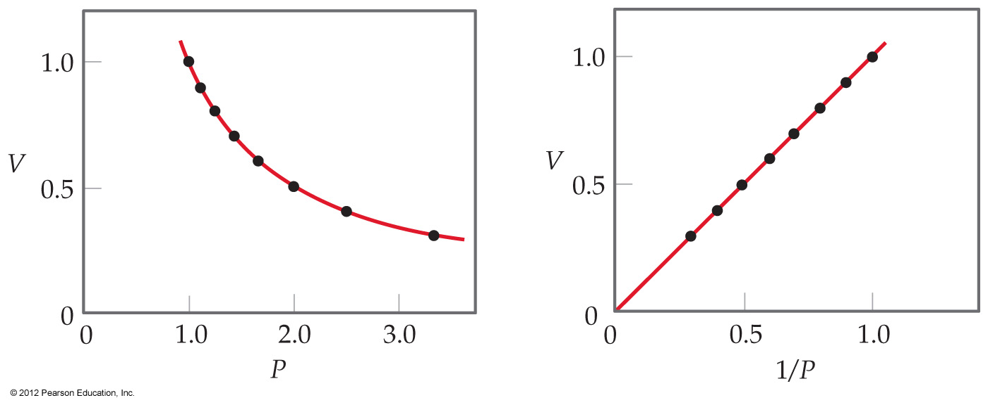
Boyle’s PV Law
More specifically, you will find that pressure and volume are
inversely proportional
Mathematically:
(Note: T is constant)
Graph V vs P is a curve.
Graph V vs 1/P is a line.

Slide 10
Charles’s VT Law
Hot air rises. When air is heated, it becomes less dense and rises.
Because density = mass / volume, there are two ways to decrease density: decrease mass, or increase volume.
If the amount of air is constant, mass is constant. So hot air rises because its volume has increased.
Generally, if temperature increases, then volume increases.

Slide 11
Charles’s VT Law
Specifically you will find they are directly proportional.
(Note: Pressure is held constant and T is in Kelvin)
Mathematically:

Slide 12
Charles’ VT law Sample Problem
Ex: A sample of gas has a volume of 2.80 x 10⁻³ m³ at an unknown temperature. When the sample is submerged in ice water at T = 0 ◦C, its volume decreases to 2.57 x 10⁻³ m³. What was its initial temperature?

Slide 13
Charles’ VT law and Absolute Zero
If you measure the volume of a gas at several temperatures and then plot V vs T, your graph can be extrapolated to find absolute zero!!
All gases produce the same absolute zero result.

Slide 14
Gay-Lussac’s PT Law
Generally, if temperature increases, then pressure increases.
From KMT: higher Temp→ faster particles→ more forceful collisions→ Higher pressure
Specifically you will find they are directly proportional.
Note: Volume is held constant and T is in Kelvin.

Slide 15
Combined gas law
Gay-Lussac’s, Charles’s Law and Boyle’s Law can be combined together:
Solve problems using the same basic strategy.
Ex: A scuba diver takes a 2.8 dm³ balloon from the surface, where the temperature is 34◦C, to a depth of 25 m, where the temperature is 18◦C. What is the volume of the balloon at this depth? (For every 10 m of water, the pressure increases by 1 atm.)

Slide 16
Avogadro’s Law
When temperature and pressure are held constant, if the amount of gas is increased, the volume of the sample increases. (e.g. balloon)
Experiments show that this is a direct proportionality.
Mathematically:

Slide 17
Deriving the Ideal Gas Law
Summarize all 3 proportionalities into one:
The proportionality constant is R, the gas constant.
Or R = 0.0821 atm L/mol K
Only PV = nRT in Data Packet
The units on R determines the units for all other variables.
P in Pa, V in m³, n in mol, T in K

Slide 18
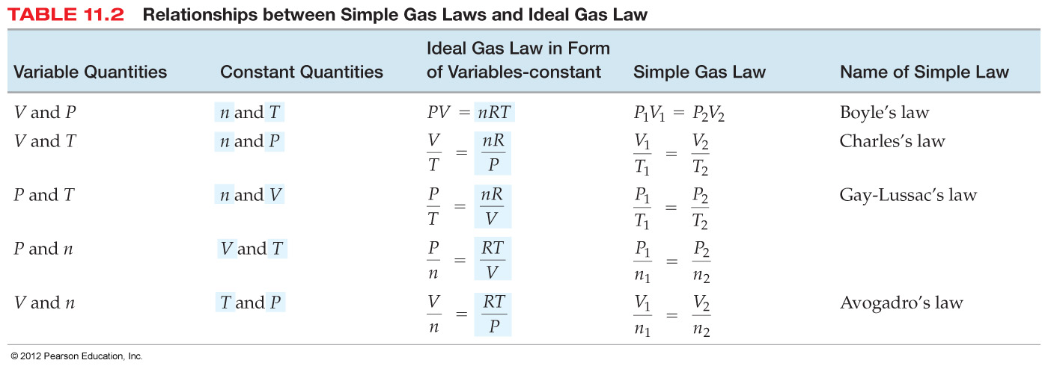
Ideal gas law and simple gas laws
How to derive
all the simple
gas laws from
the ideal gas law:
Ex: A cylinder contains 28.5 dm³ of oxygen gas at a pressure of 180 kPa and a temperature of 25◦C. How many moles of O₂ gas molecules are present? (watch units!)

Slide 19
Exit Slip - Assignment
Exit Slip- none
What’s Due? (Pending assignments to complete.)
Ch 3.2, p140, 13-21
What’s Next? (How to prepare for the next day)
Read 3.2 p126-136 about Gases

